Slide 1
Computer Vision
Segmentation and detection in videos
Authors:
Buzatu Rares Tudor
Stuparu Maria Andreea
Master: Artificial Intelligence

Slide 2
TOPICS
Introduction
Semantic segmentation
Labelling the dataset
Training the net
Output
Depth enhancement
Used model
Output
Blob object tracking
Detection method
Tracking method
Final results
Conclusions

Slide 3
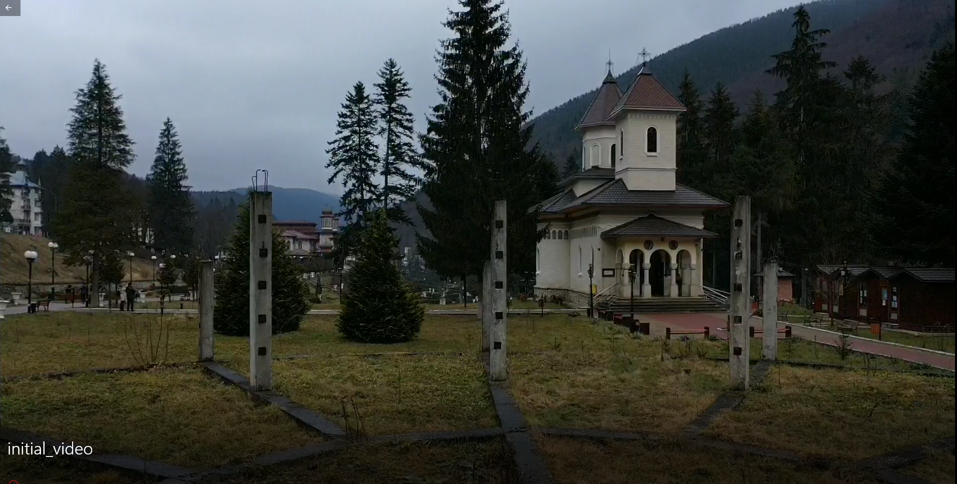
Introduction
Multiclass semantic segmentation: “Slanic Moldova” video ^{[1]}
Extension of the segmentation task
Particularization on input video
1. Marius Leordeanu, Slanic Moldova Video, https://drive.google.com/drive/folders/1P5JwPclNqvBhDRyIK_kAP_lx8gt-YXoW

Slide 4
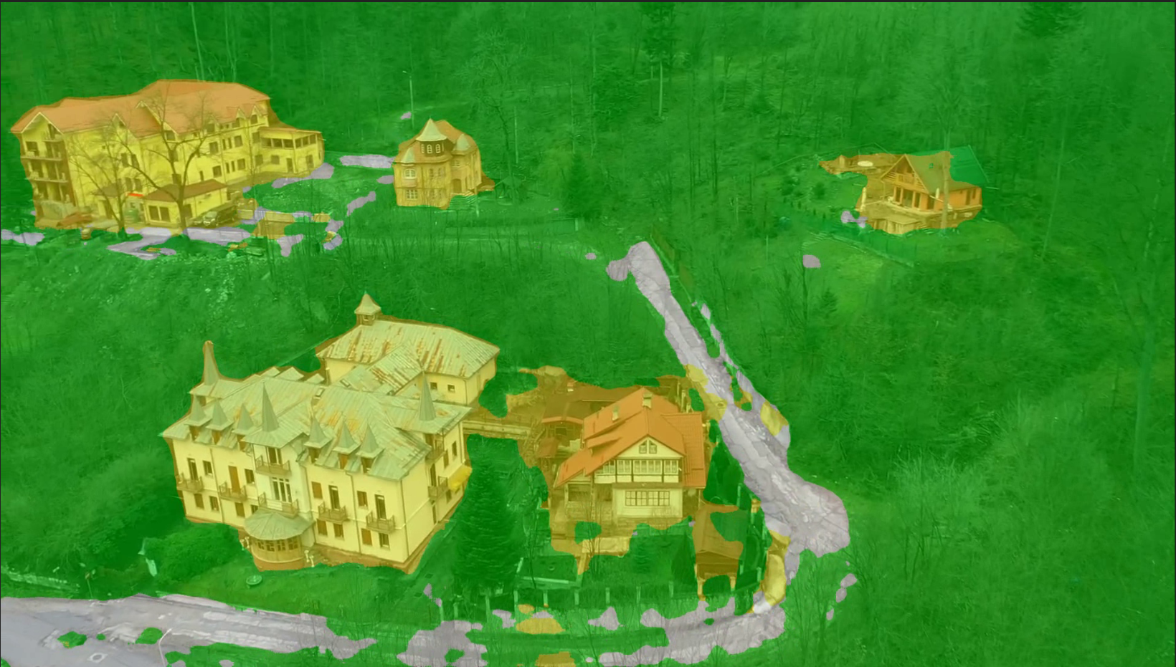
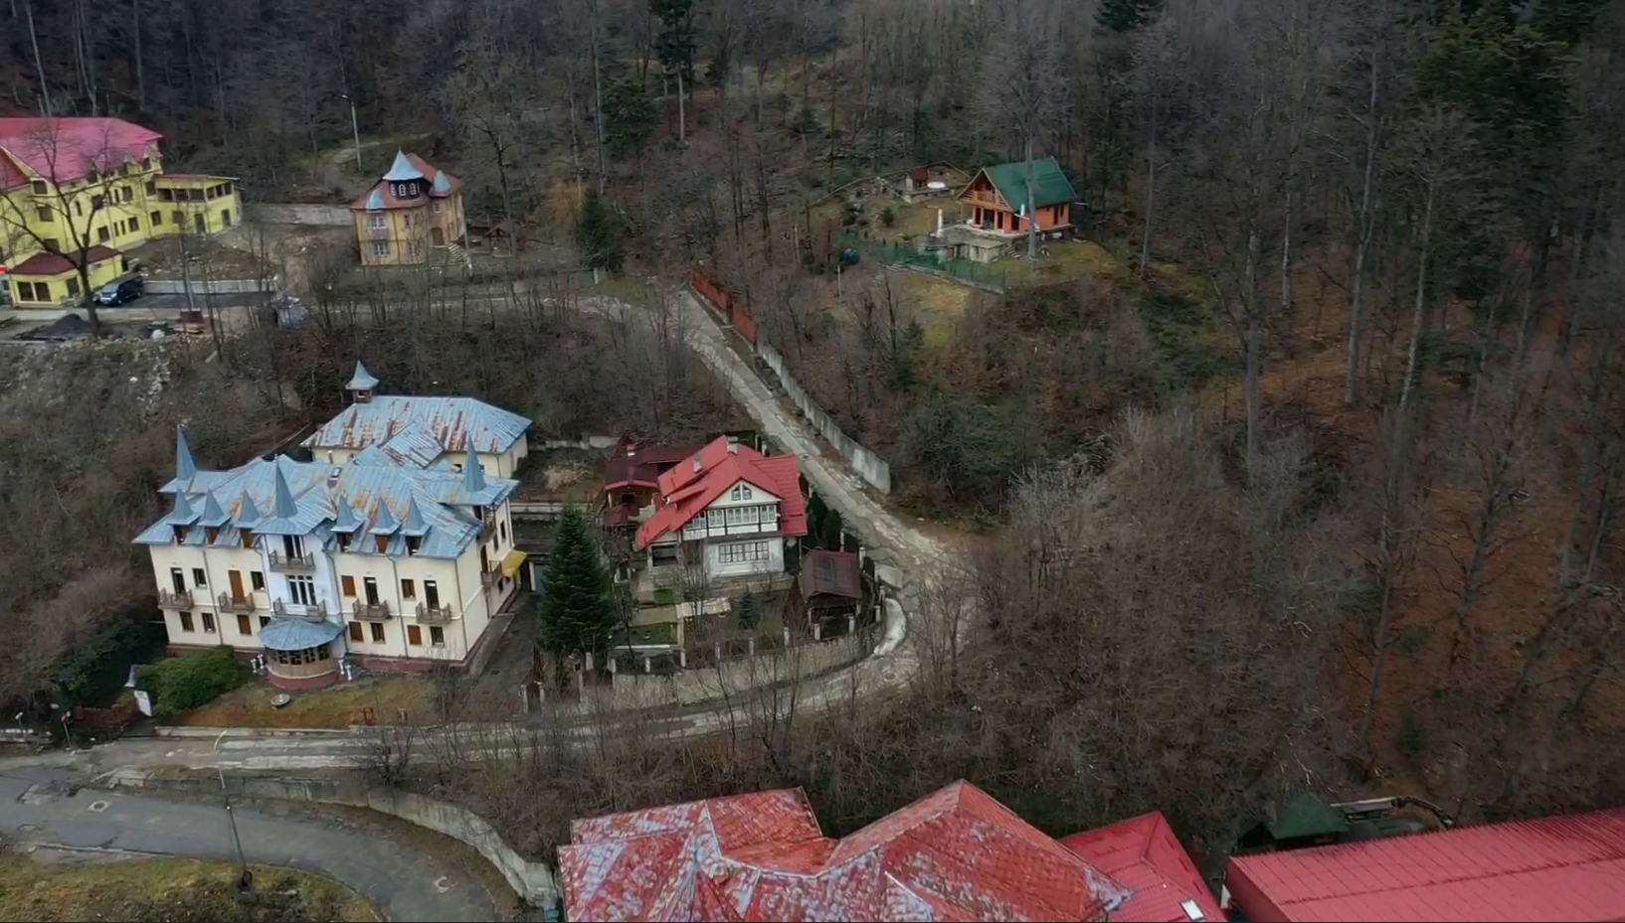
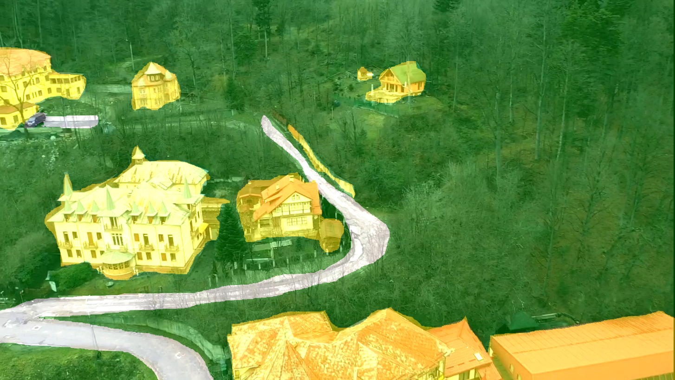
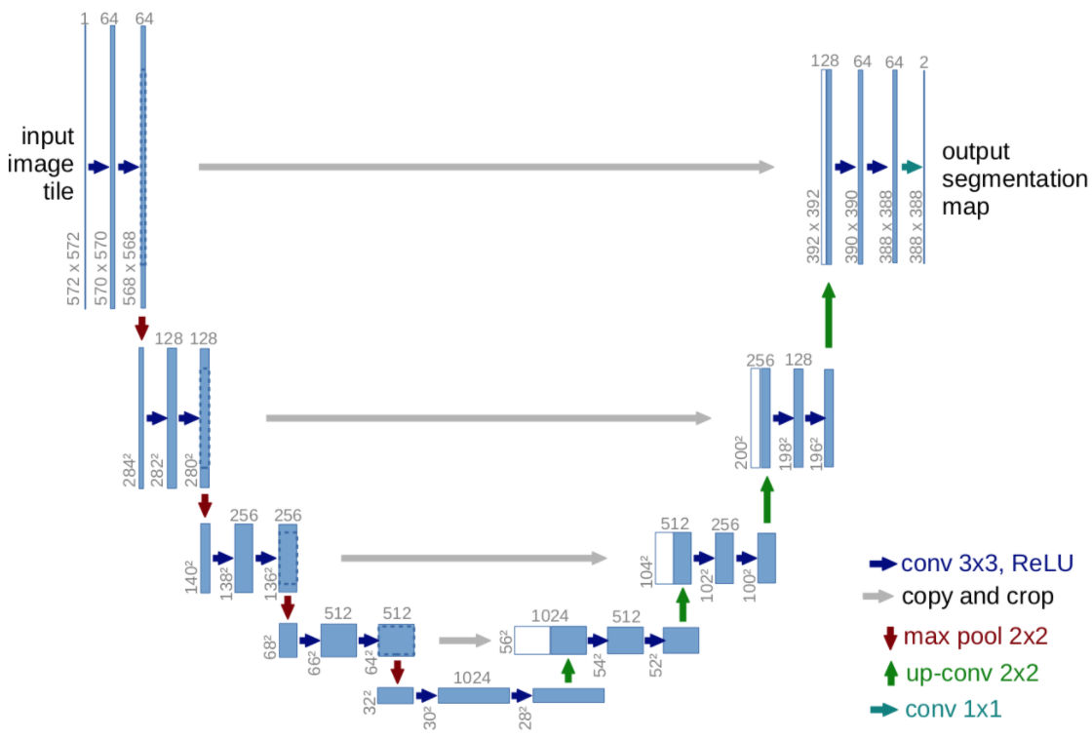
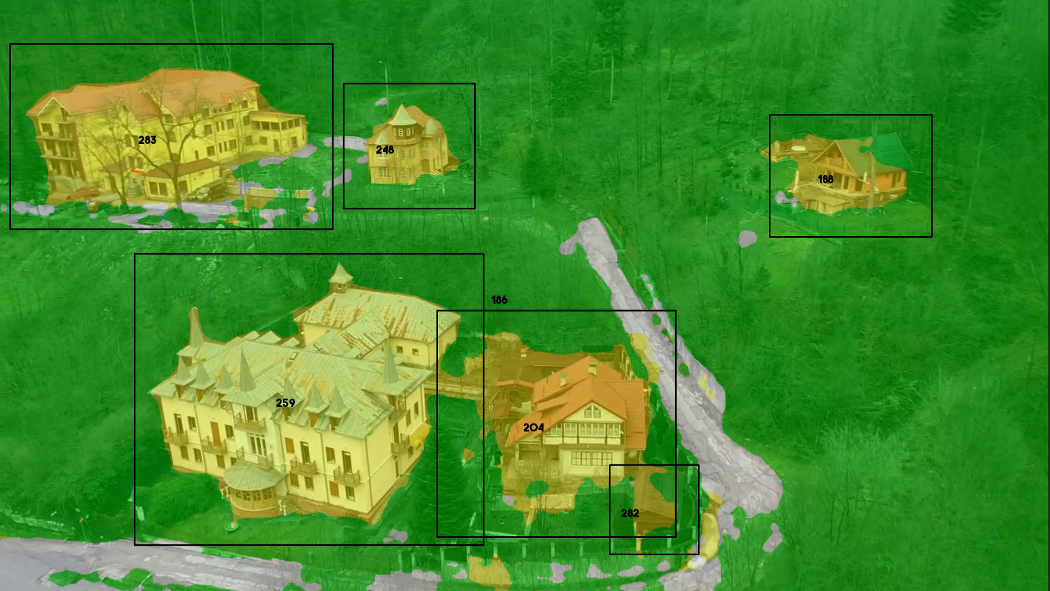
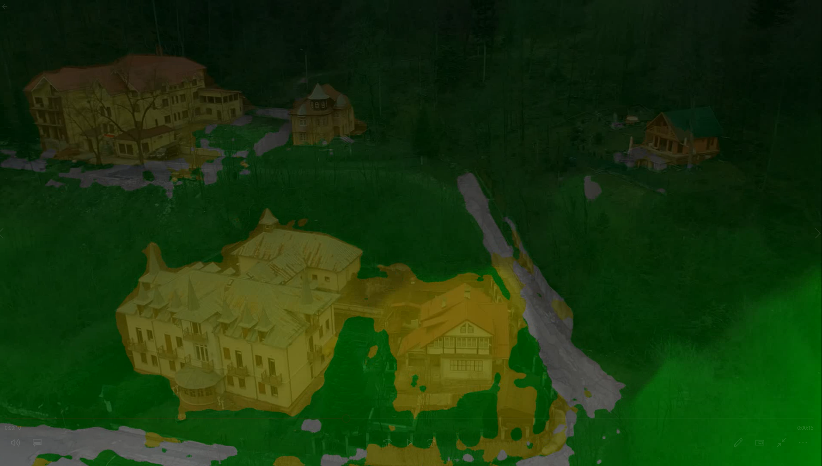
Introduction: work-flow
Segmented frames
Original frames
Manual labeling
U-Net^{[2]}
Object tracking
Detection + Tracking algorithm
Depth estimation
Monodepth2 Net
2. https://towardsdatascience.com/unet-line-by-line-explanation-9b191c76baf5

Slide 5
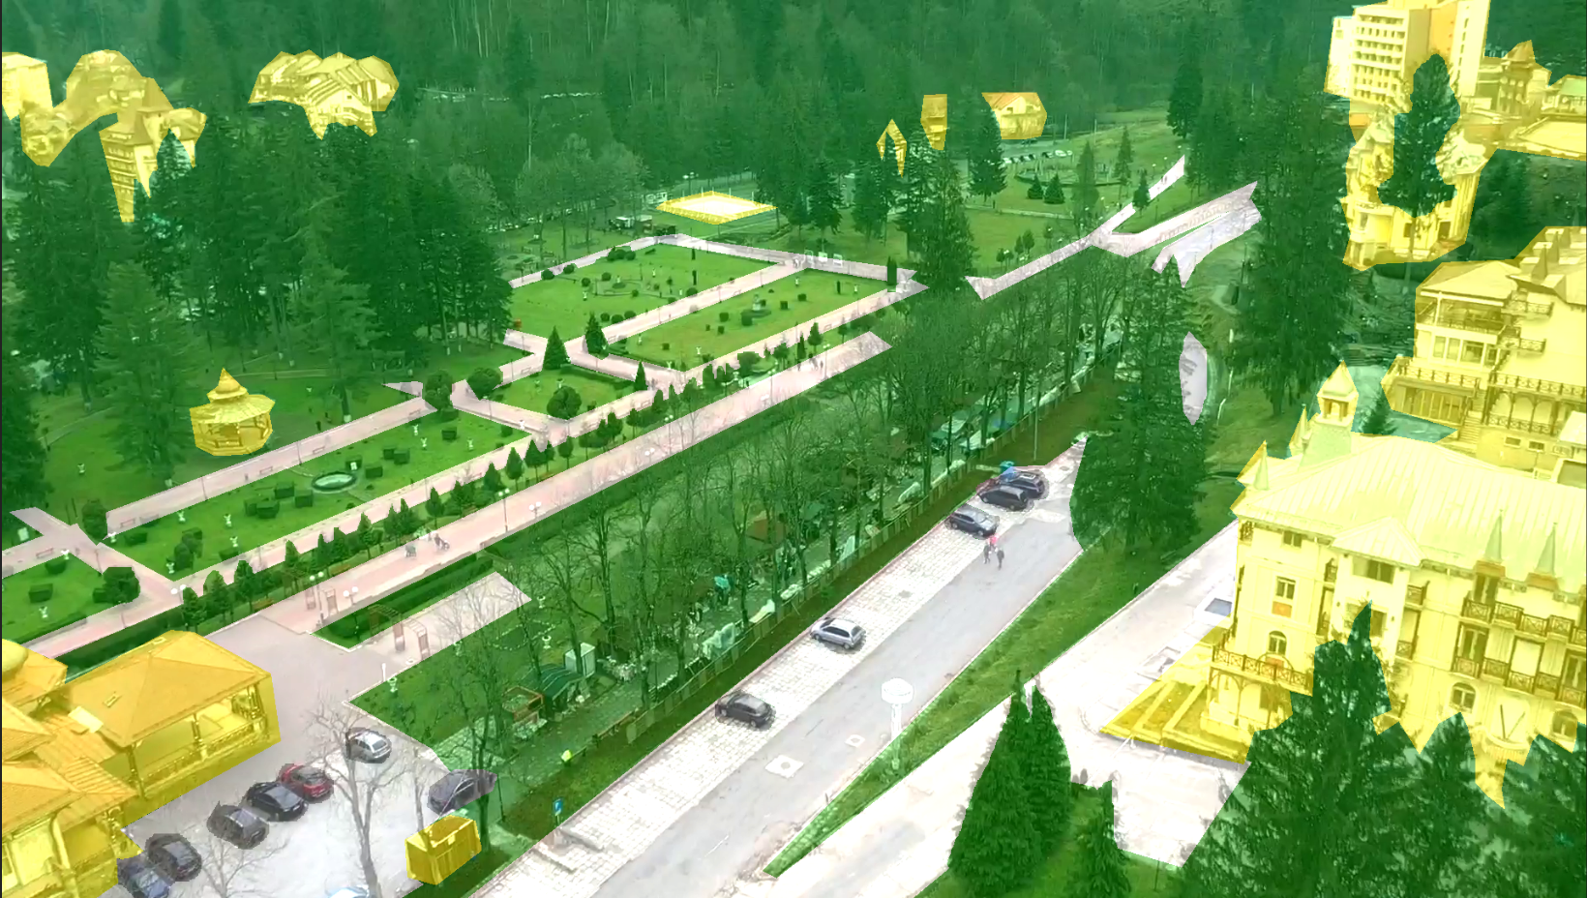
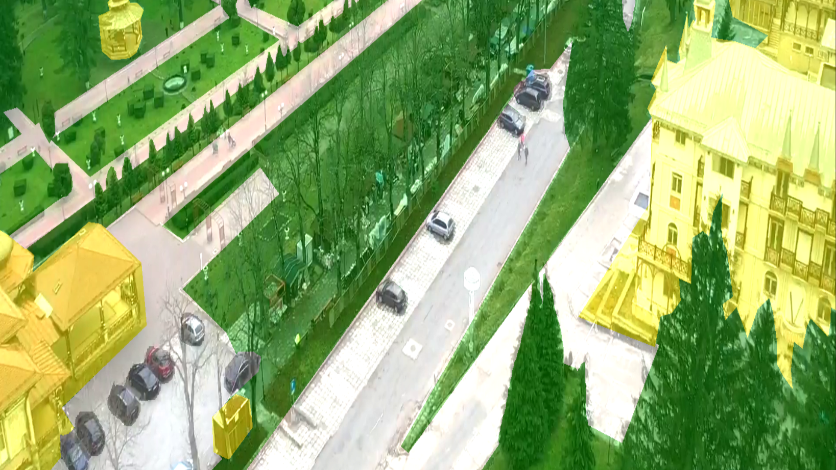
Semantic segmentation: Labeling the dataset
Software used: frameSeg.py ^{[3]}
4 classes: residential, infrastructure, vegetation, cars
46 manually segmented frames
64 augmented frames: crop + flip
Total: 100 fine-tuning frames
Augmentation
3. https://github.com/onorabil/frameSegmentation

Slide 6
Semantic segmentation: training the net
U-Net: SafeUAV ^{[4]}
SafeUAV – Last Conv Layer + Conv2d(4)
Acc metric = dice coefficient
Train / Test split = 80 / 20 ; Nr frames = 5 minute * 30 frames / sec
15 epochs: L.R. = 0.01; frozen layers=> 64% acc
15 epochs: L.R. = 0.0001; unfrozen layers => 85% acc
4. Marius Leordeanu, Alina Marcu, Vlad Licaret, Dragos Costea, “Semi-supervised Segmentation of Aerial Videos with Iterative Label Propagation”, https://sites.google.com/site/aerialimageunderstanding/semantics-through-time-semi-supervised-segmentation-of-aerial-videos

Slide 7
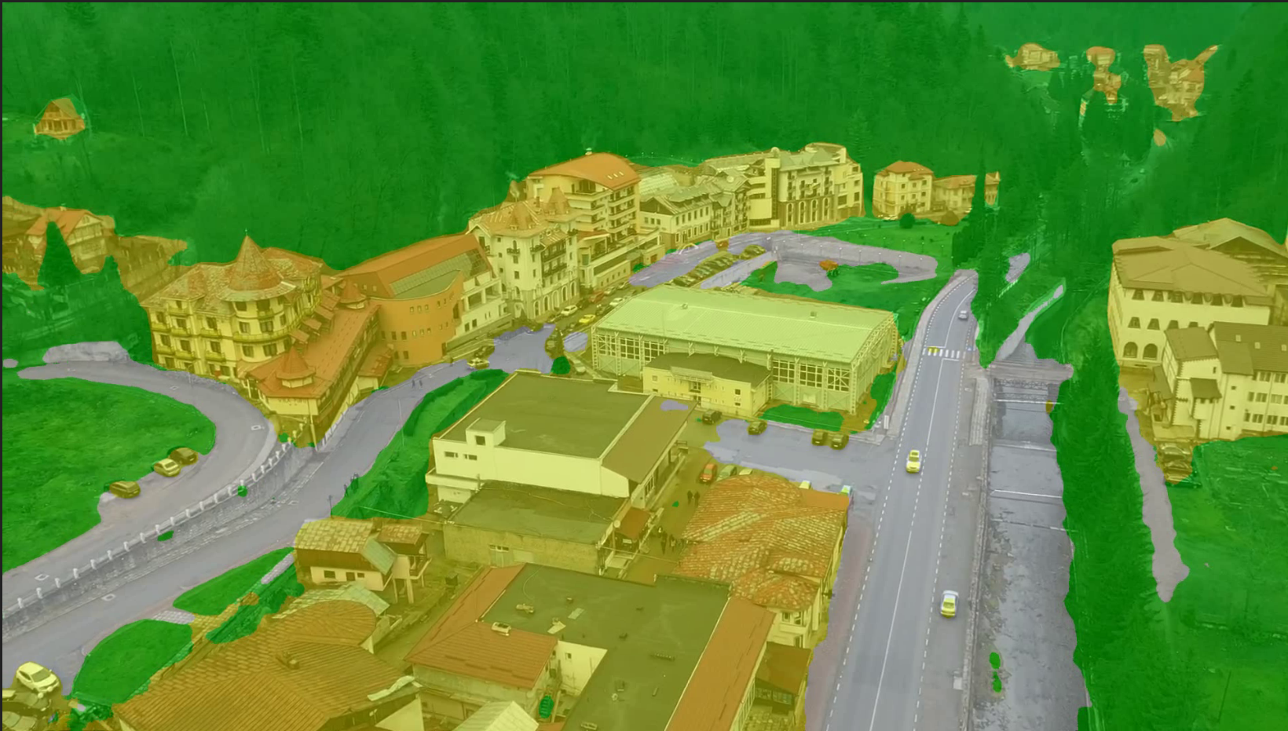
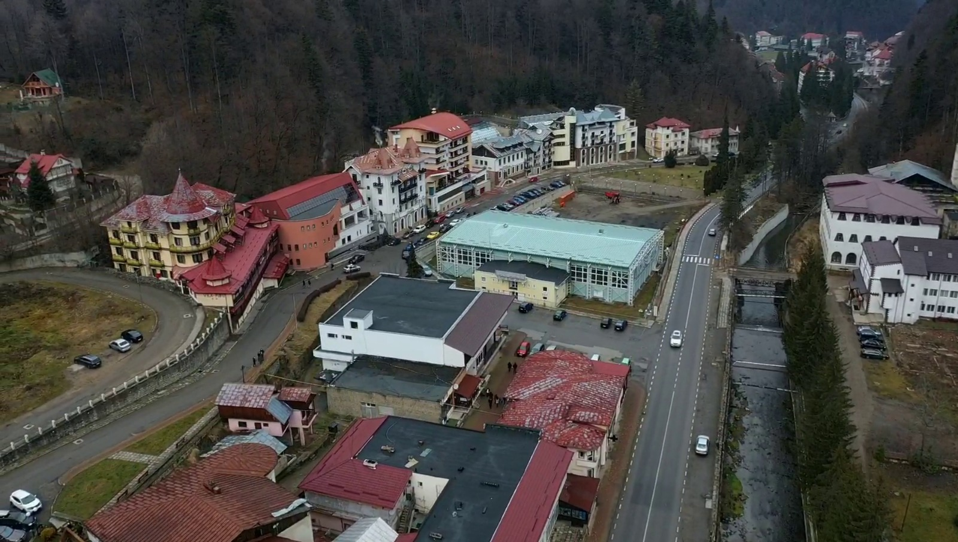
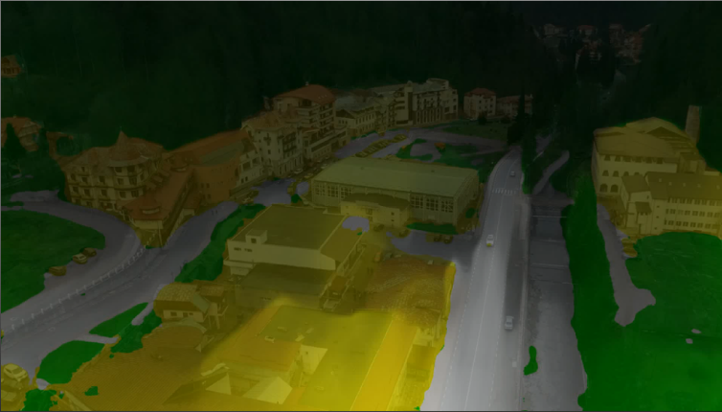

Depth enhancement: Used model (Monodepth2 Net^{[5]})
2 networks:
Depth Network with U-Net model
Pose Network with ResNet18
SafaUAV
Monodepth2
5. C. Godard, O.M. Aodha, M. Firman, G. Brostow, “Digging Into Self-Supervised Monocular Depth Estimation”, arXiv:1806.01260v4 [cs.CV] 17, Aug 2019, https://arxiv.org/pdf/1806.01260.pdf

Slide 8
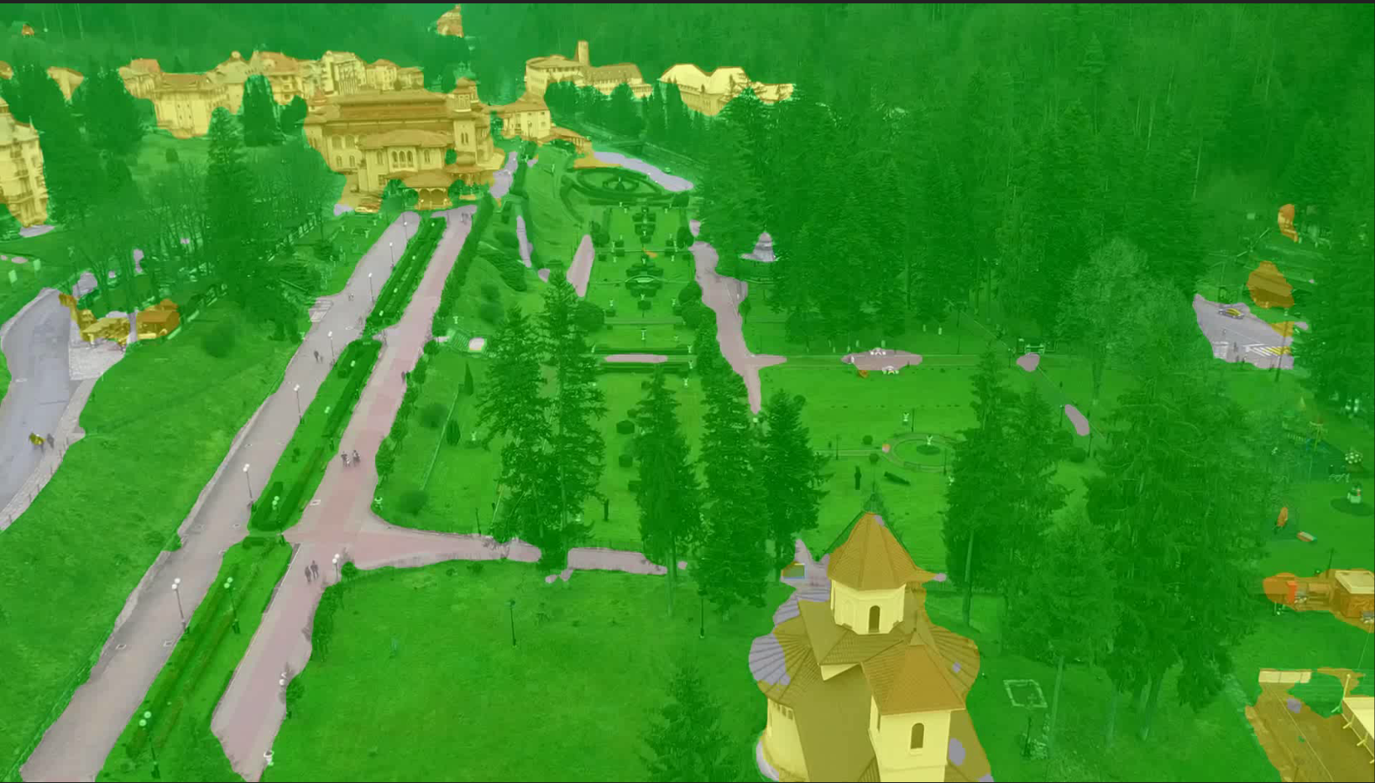
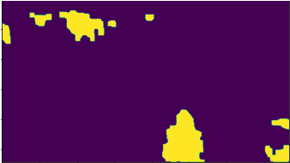

Blob object tracking: Detection method
Purpose: Track residential areas
Binarizing segmented frame
Eliminate small areas: Erosion (kernel=(50,50))
Create continuous blobs: Dilatation ( kernel = 40,40)
Blob contours
Blob center = ((Xmin+Xmax) / 2, (Ymin+Ymax) / 2)
Segmented frame
Binary image
Blob detected frame

Slide 9
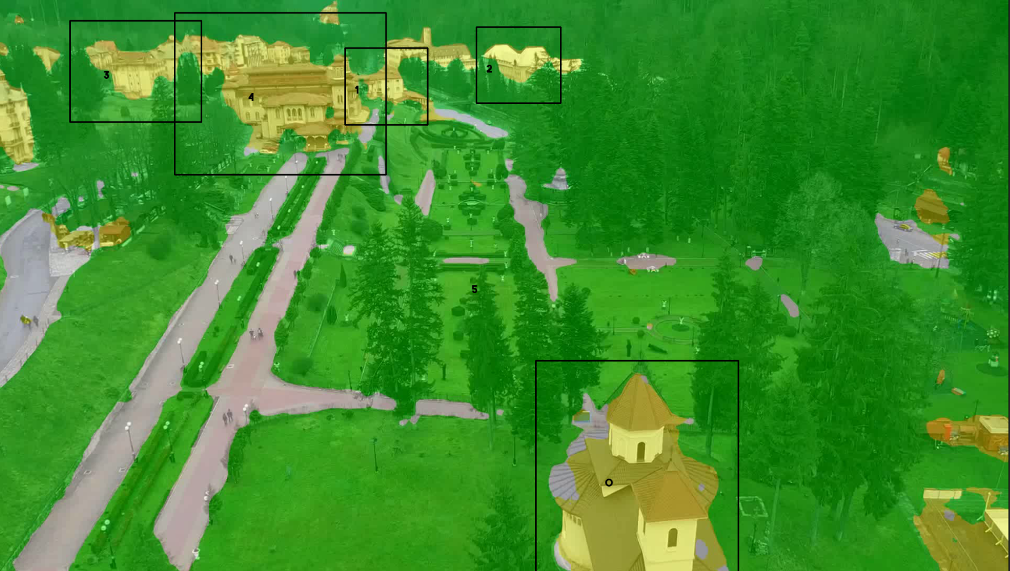
Blob object tracking: Tracking method
Association: blob center – TAG
Compute Euclidean distance: new centers – old centers
If min distance(NewCi, OldCj) < threshold => same TAG else new TAG
Tracking

Slide 10
Conclusions and improvements
Segmentation – good results – few labeled frames
Segmentation –failed small details
Object detection – good results – with segmentation – with erosion & dilation
Depth estimation – possible improvements – fine-tuning

Slide 11
Thank you!

